Slide 1
Real Estate Affordability based on Price to Income and Venue Data Analysis of London, UK
Elnaz Limouchi
April 2020

Slide 2


Introduction
Main goal:
choose the regions of London, UK where real estate are more affordable
select the area according to the social places density
Solution Strategy:
creating a map of London and inserting the information on that
clustering each area based on the density of venue

Slide 3

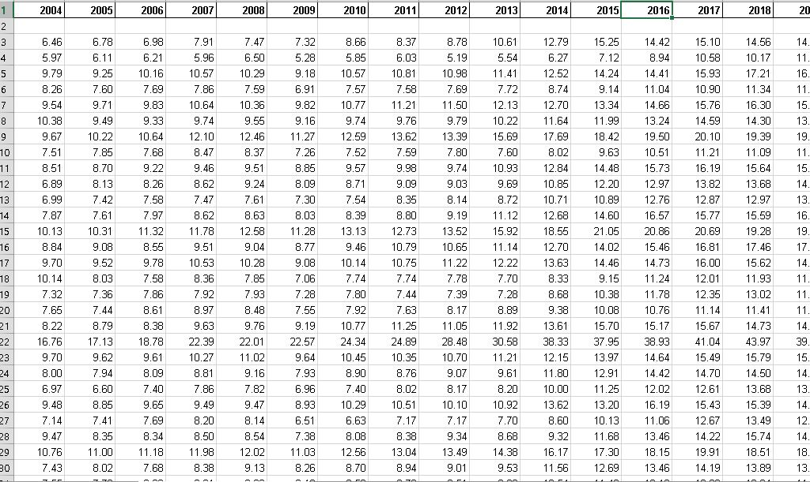
Data Description
In order to perform the analysis, these datasets are considered:
Ratio of House Prices to Earnings (full-time workers by place of work) of London
Forsquare API to get the most common venues of given Borough of London

Slide 4
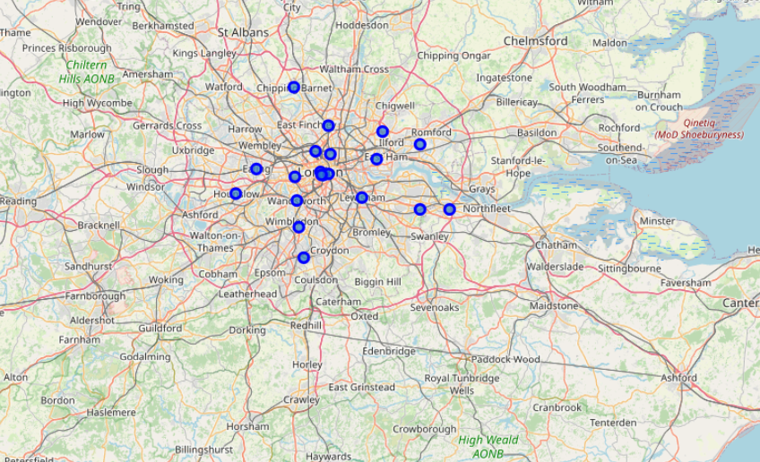
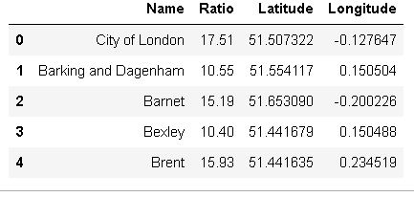
Methodology
In this work, GitHub repository is used as the database. The data includes the Borough (Name), Ratio, Latitude and Longitude information of the London area.
Using python folium library, geographic details of London and its boroughs are visualized.

Slide 5
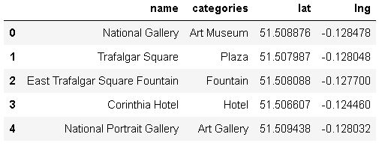
List of venues of London by Foursquare
The list of venues name, category, and latitude and longitude information are obtained using Forsquare API. It is considered to have the limit as 100 venue and the radius as 500 meter for each borough.

Slide 6
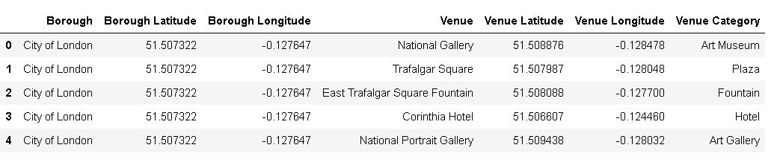
Merged table of boroughs and venues
The merged table of boroughs and venues created.

Slide 7
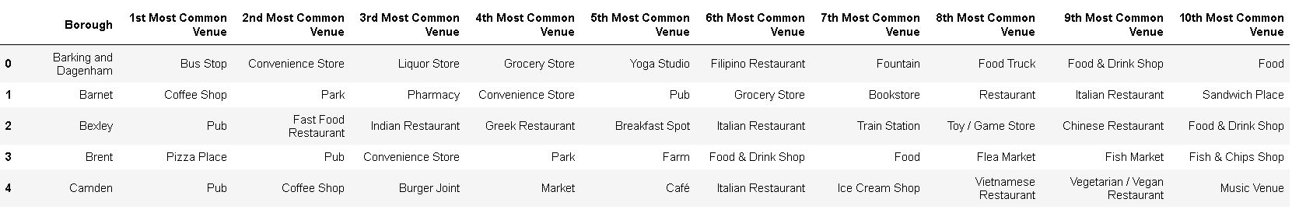
List of top 10 venue category for each borough
187 unique categories were returned by Foursquare, then a table which shows list of top 10 venue category for each borough is created.

Slide 8
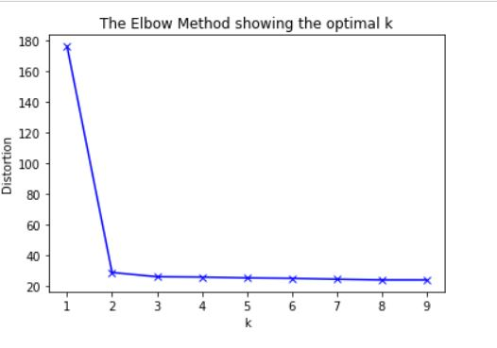
K-Mean Algorithm
Since there are some common venue categories in boroughs, the unsupervised learning K-means algorithm is used to cluster the boroughs. K-Means algorithm is one of the most common cluster method of unsupervised learning.
Running K-Means to cluster the boroughs into 2 clusters

Slide 9
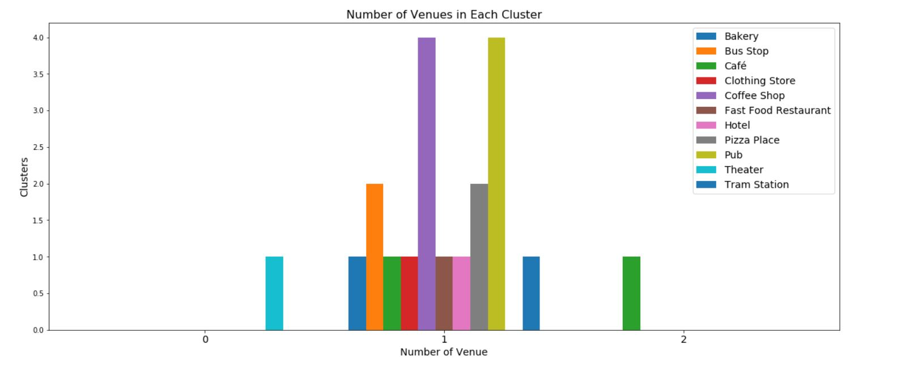
Number of Venues in Each Cluster
A bar chart which may help us to find proper labels for each cluster is created.

Slide 10
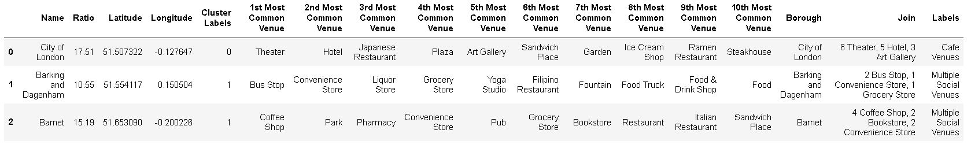
Result
By merging the new variables with the related cluster information in our main master table.

Slide 11
Discussion
Using Kmeans algorithm as part of this clustering study. Based on the Elbow method, the optimum k value is set to 2. However, only 20 district coordinates were used.
Also, data analysis was done through this information by adding the coordinates of districts and affordability as static data on GitHub.
This work finalized by visualizing the data and clustering information on the London map.
As a result, people can achieve better outcomes through their access to the platforms where such information is provided in order to make a decision regarding business start/development.

